Slide 1


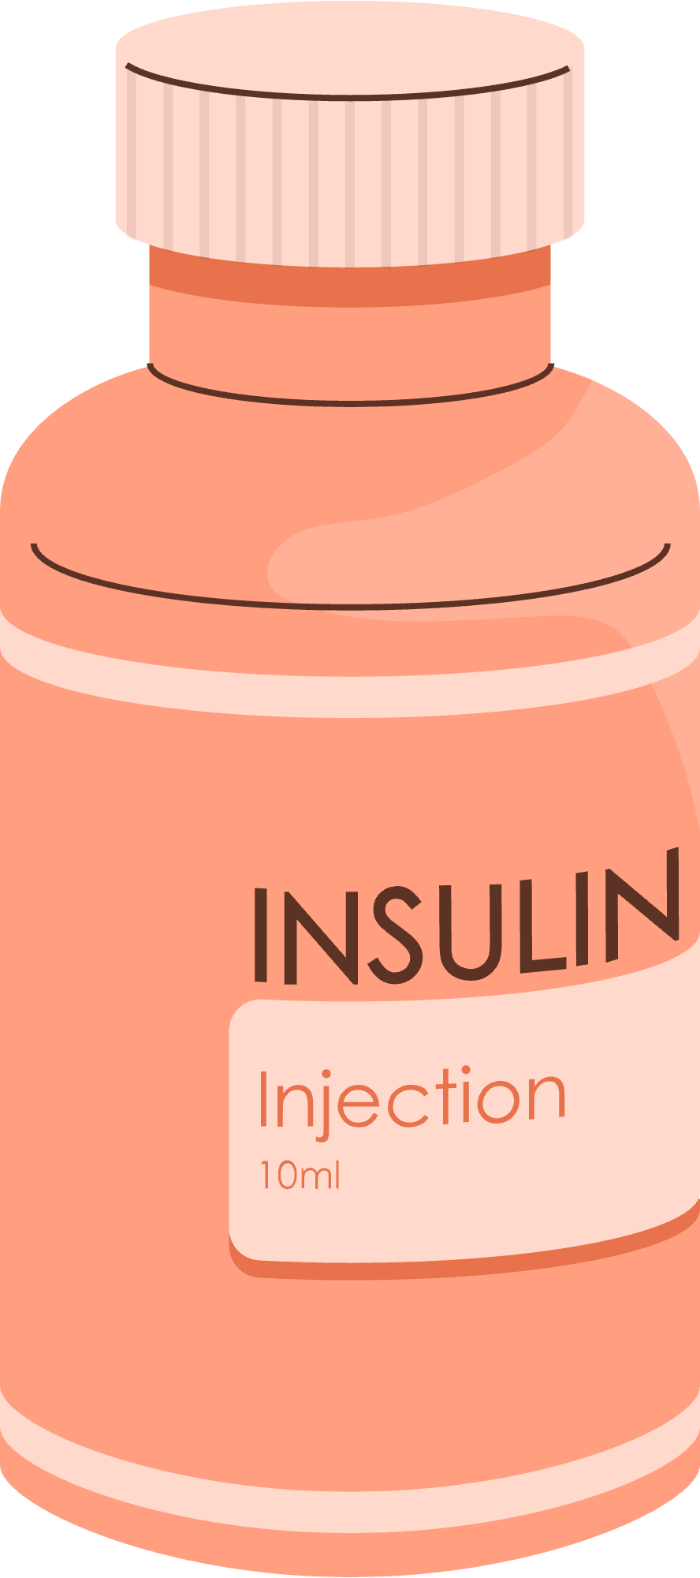
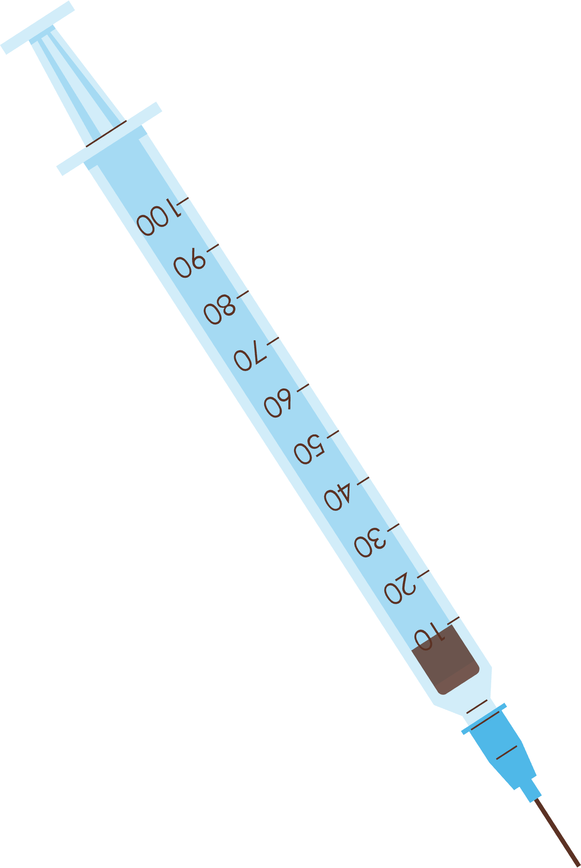


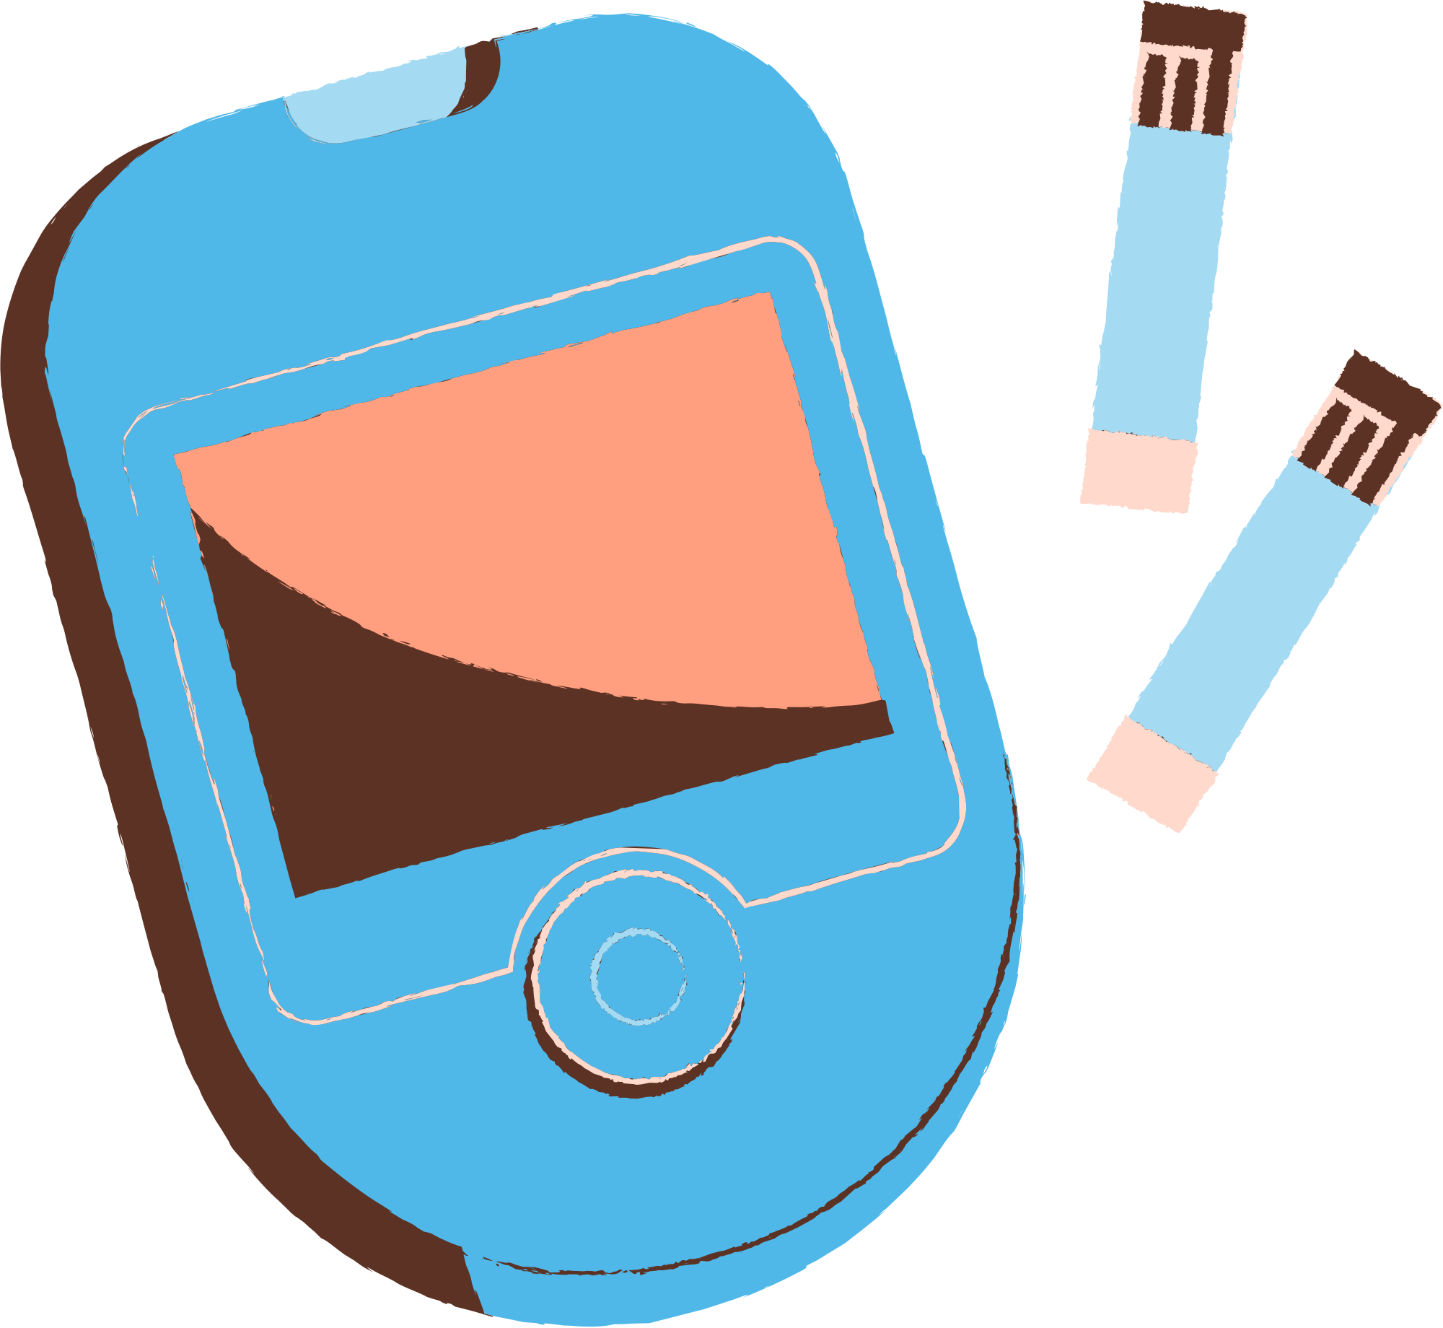
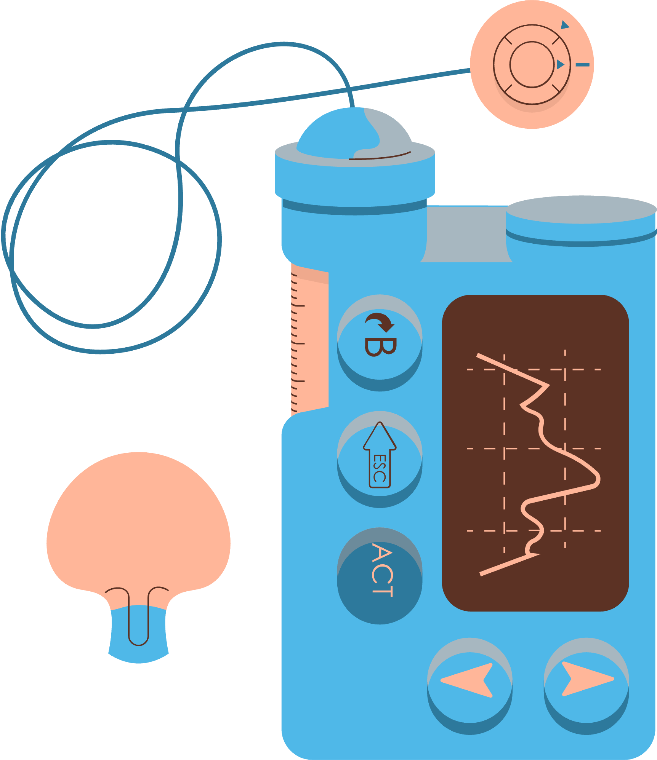
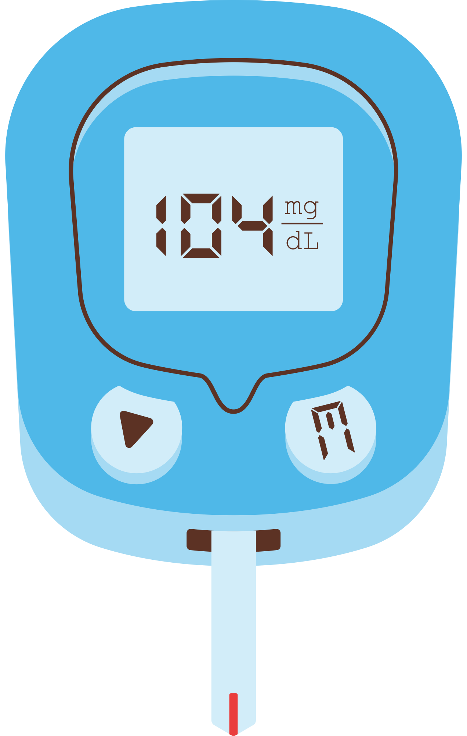

Analysis of Lifestyle as
a Health Indicator for Diabetes
Mukesk Rajmohan
Priyanka Avagadda
Pranavi Rao Lingala

Slide 2
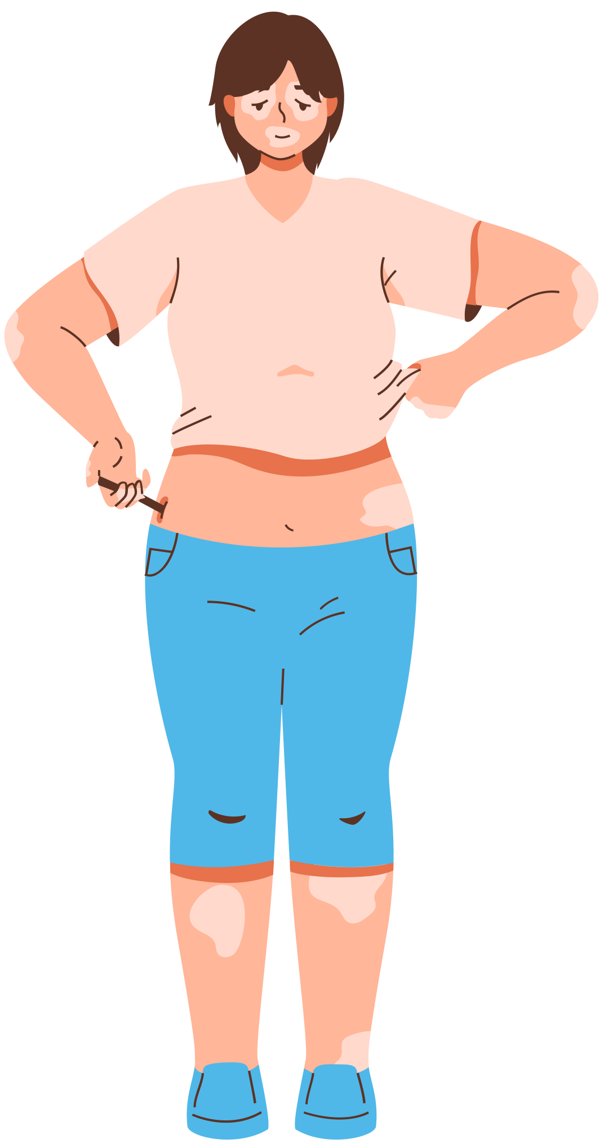

INFLUENCE OF LIFESTYLE FACTORS ON THE PREVALENCE OF DIABETES IN UNITED STATES.
Diabetes is a chronic medical condition that occurs when the body is unable to effectively regulate blood sugar (glucose) levels. Glucose is the primary energy source for the body's cells, and insulin, a hormone produced by the pancreas, facilitates the uptake of glucose into cells.

Slide 3

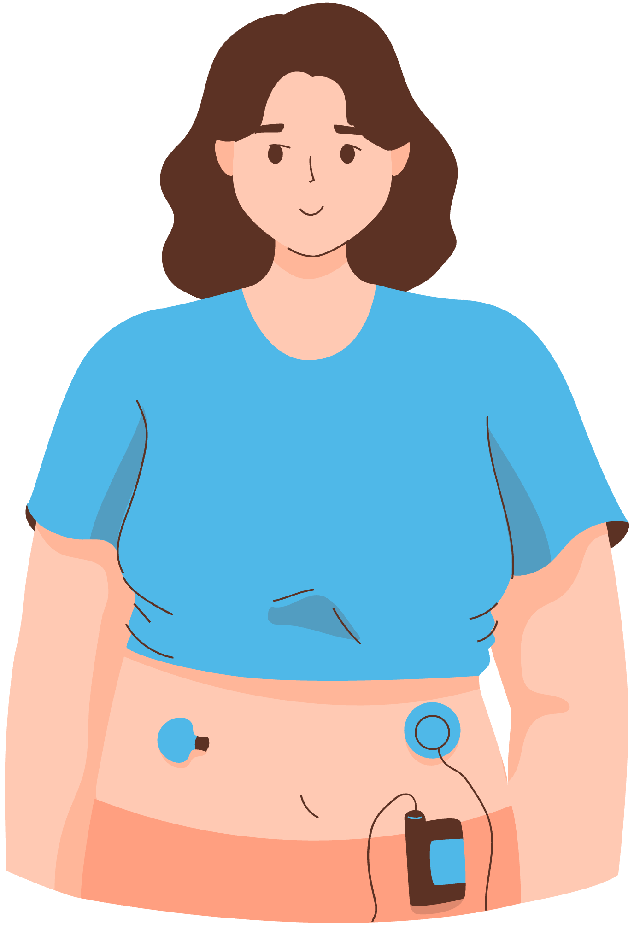

WHAT ARE THE DIFFERENT TYPES OF DIABETES?

Slide 4
Type 1 Diabetes
· An autoimmune condition where the immune system attacks and destroys insulin-producing beta cells in the pancreas.
· Commonly diagnosed in children and young adults but can occur at any age.

Slide 5
Type 2 Diabetes
· A condition where the body becomes resistant to insulin or the pancreas doesn't produce enough insulin.
· It is more common in adults but increasingly seen in children and adolescents.

Slide 6
Gestational Diabetes
· Being overweight or physically inactive before or during pregnancy increases the risk.
· A history of unhealthy eating patterns may also contribute to the development of gestational diabetes.

Slide 7
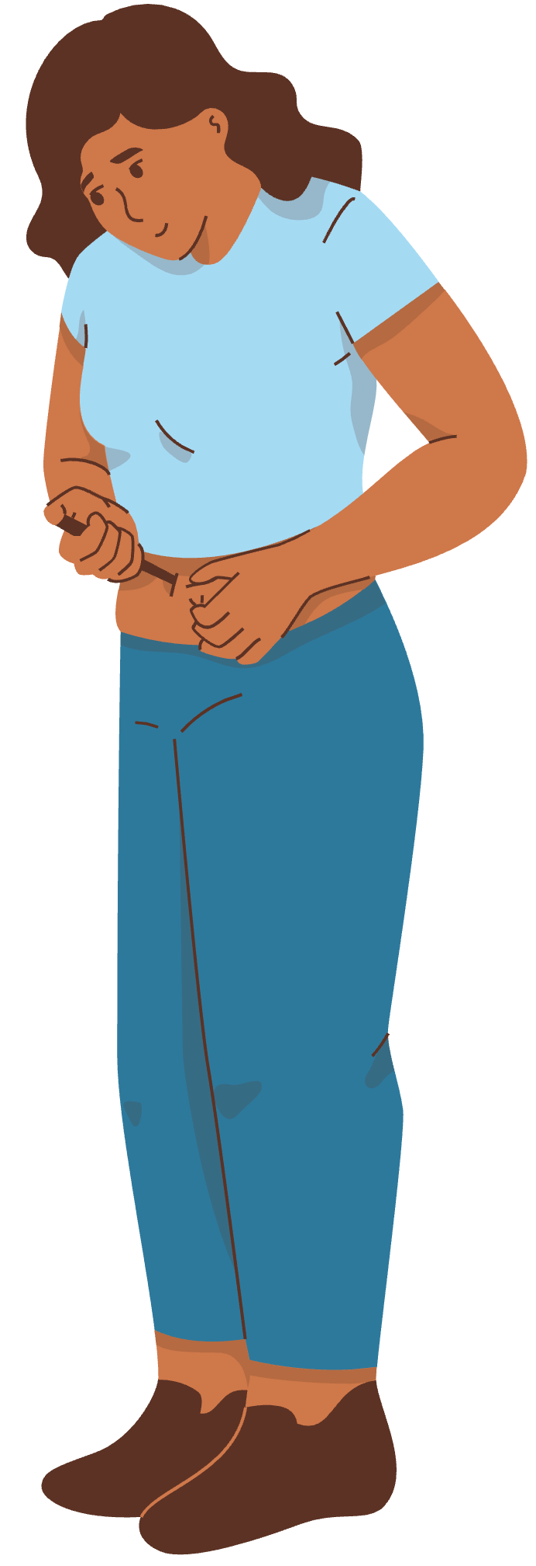
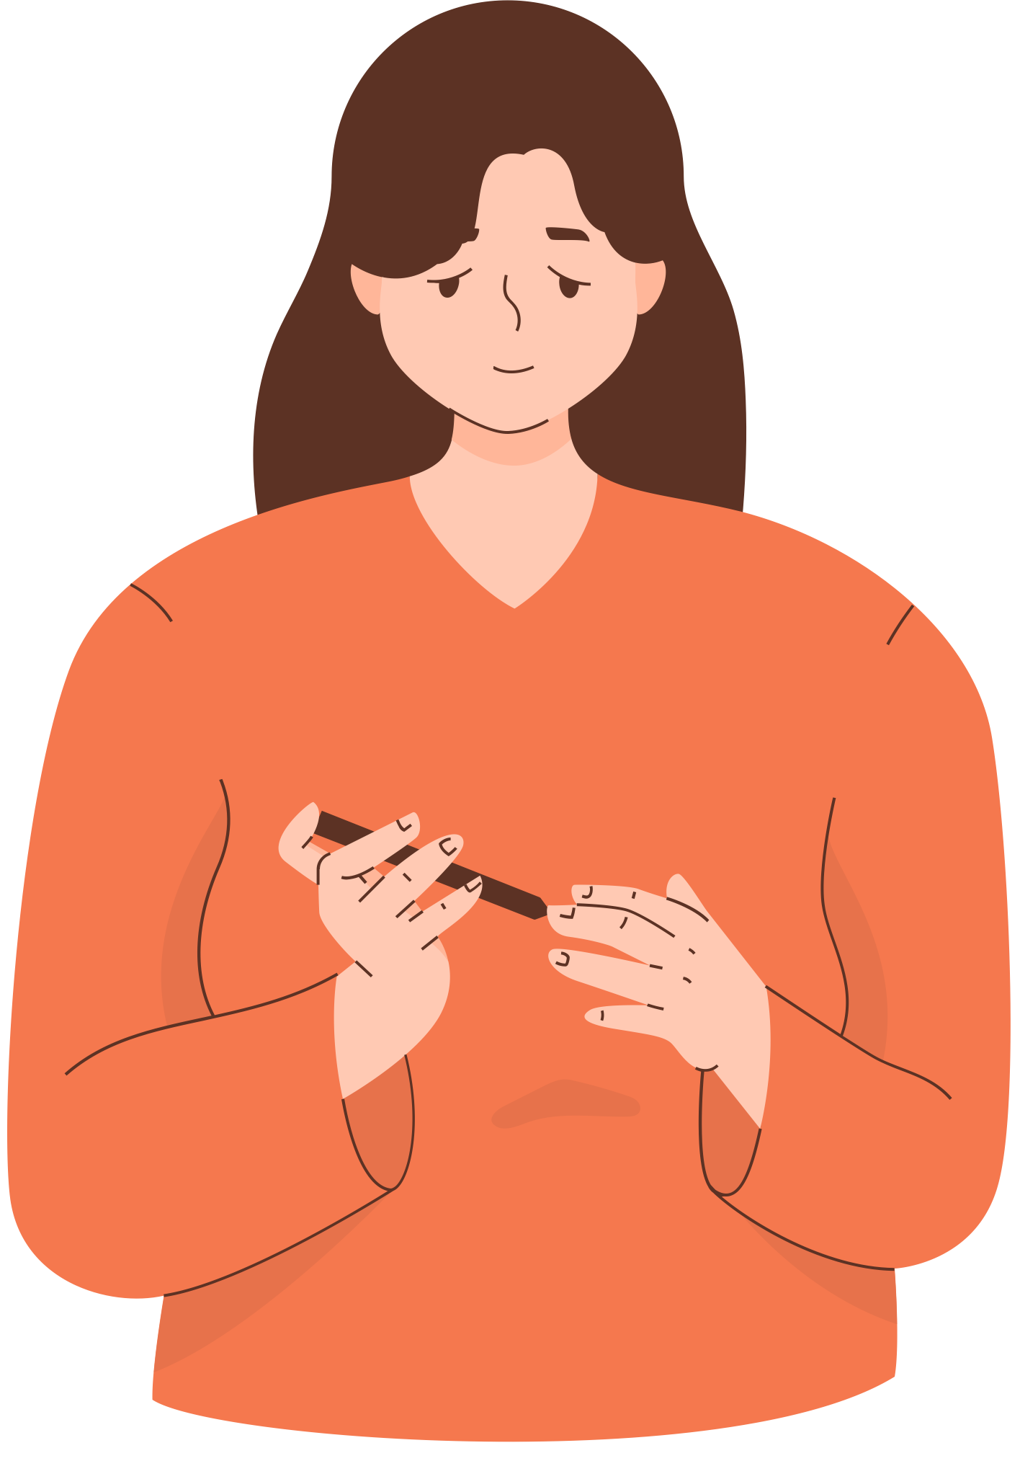
RELATIONSHIP BETWEEN LIFESTYLE FACTORS AND DIABETES
Type
1
Type
2
Genetic Condition
Obesity
Physical Inactivity
Unhealthy Diet
Smoking
Alcohol

Slide 8
SIGNIFICANCE OF DIABETES AS A GLOBAL PROBLEM
Diabetes is a critical public health challenge with widespread implications for individuals, healthcare systems, and societies. Its significance lies in its global prevalence and potential for severe complications if left unmanaged.
1. Rising Global Prevalence
Epidemic Scale: According to the International Diabetes Federation (IDF), over 500 million adults worldwide live with diabetes, a figure projected to rise to 783 million by 2045.
Undiagnosed Cases: Many individuals remain unaware of their condition, increasing the risk of complications and strain on healthcare systems.
Affecting All Age Groups: Type 2 diabetes, once predominantly seen in adults, is now increasingly diagnosed in children and adolescents due to rising obesity rates.

Slide 9
SIGNIFICANCE OF DIABETES AS A GLOBAL PROBLEM
2.Impact on Health
Diabetes significantly increases the risk of:
Cardiovascular Diseases
Kidney Failure
Blindness
Amputations

Slide 10


OBJECTIVE OF THE STUDY
To evaluate the top 10 lifestyle factors which are critical for the prevalence or development of Diabetes.
Analyze which data mining model pulls out the best results for the study.

Slide 11
The Centers for Disease Control and Prevention (CDC) is the national public health agency of the United States.
It is a United States federal agency under the Department of Health and Human Services.
Our dataset, “Diabetes Health Indicators” contains healthcare statistics and lifestyle survey information about people in general along with their diagnosis of diabetes.
The dataset contains 21 features such as PhysActivity, Stroke, HighBP, etc including ID and Target variable.
The target variable for classification is whether a patient has diabetes, is pre-diabetic, or healthy.
Variable type: Binary and Integers
DATA SOURCE

Slide 12
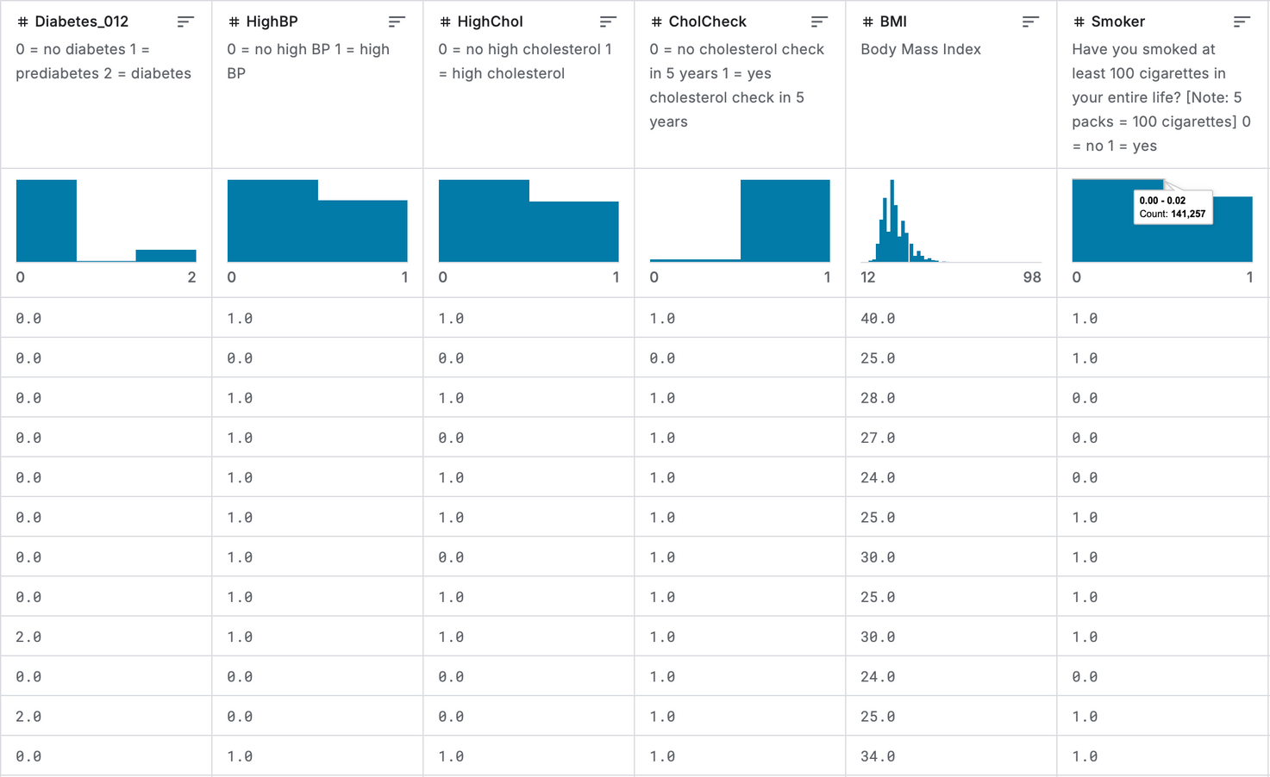
DATASET

Slide 13
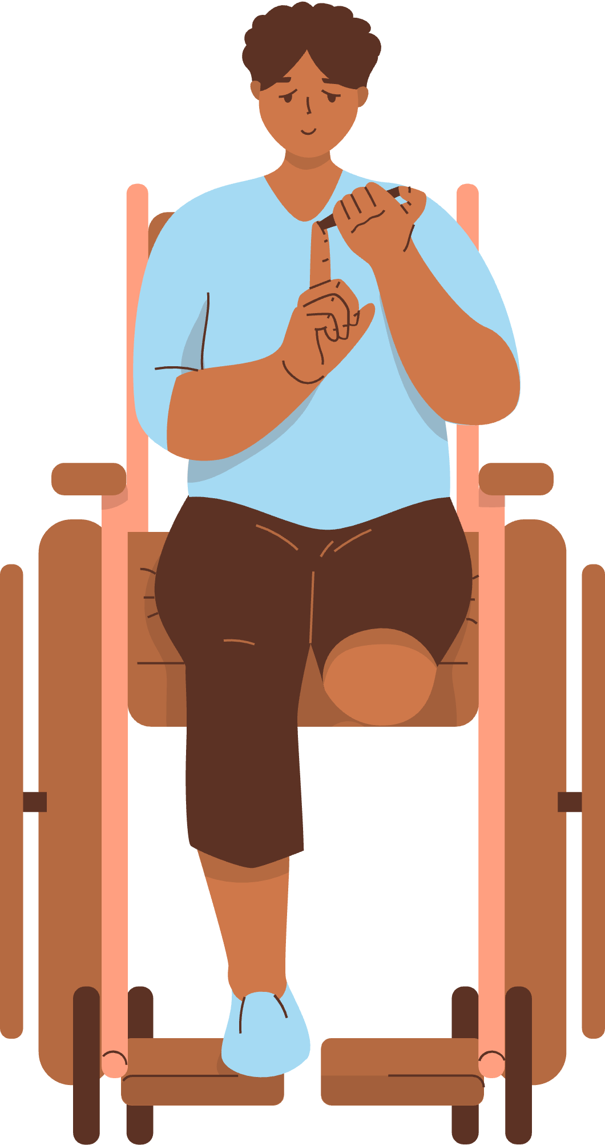
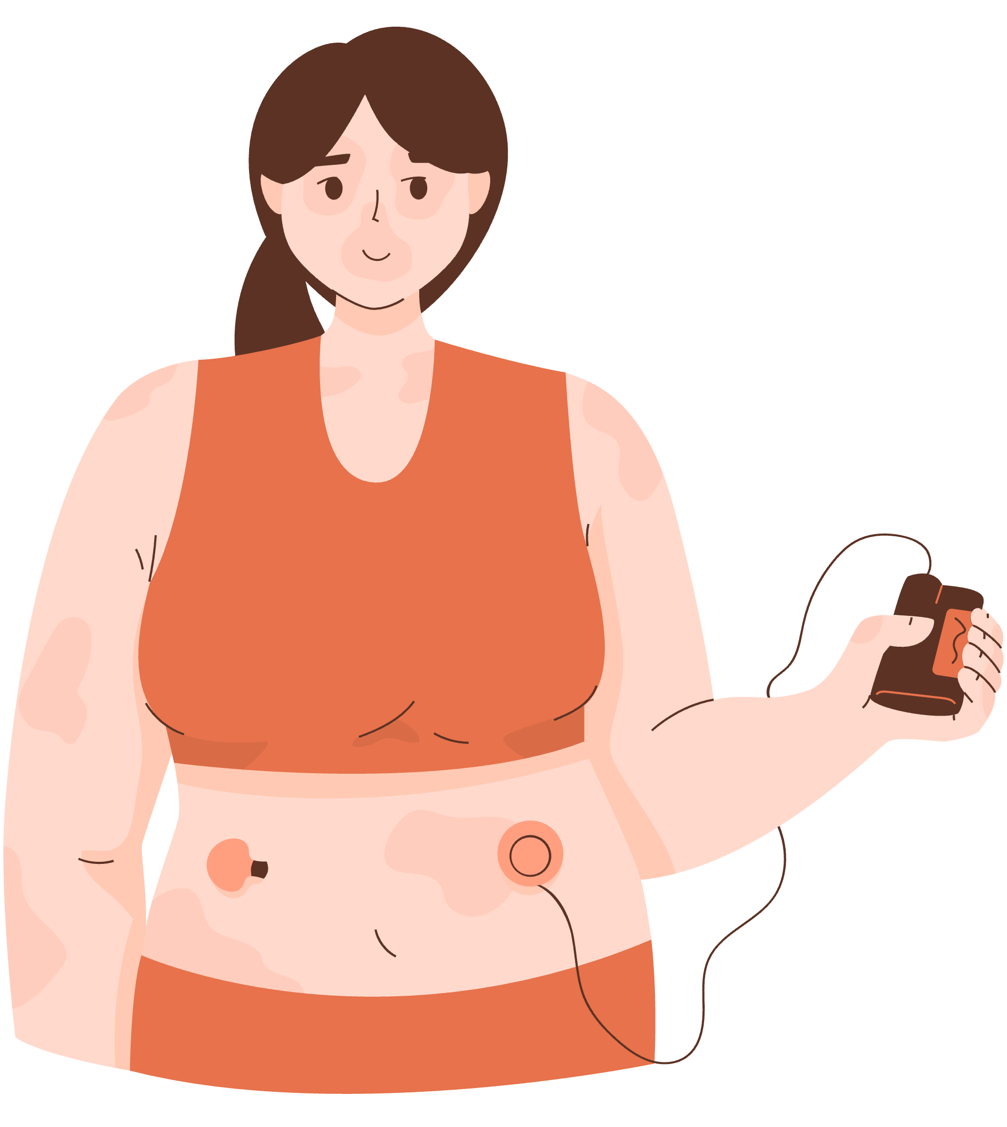
Analysis Plan
Import data into DB
Check for missing and duplicate values
Validate Binary Values
Validate Lifestyle Factors
Aggregate Age categories
Provide descriptive variables for certain factors
Adding New Lifestyle Factors for analysis
Lifestyle Score
BMI_PhysActivity
Binarize Diabetes Type
Normalize BMI
Bucketing of Physical and Mental Health values.

Slide 14
Import into Weka
Feature selection to identify top 10 lifestyle factors
Prediction of diabetes using the top 10 features

Slide 15


RESULTS
MODEL | ROC AREA | PRECISION | RECALL
LOGISTIC | 0.797 | 0.860 | 0.975
NAIVE BAYES | 0.783 | 0.895 | 0.859
DECISION TREE | 0.790 | 0.854 | 0.986
J48 | 0.709 | 0.855 | 0.983
RANDOM FOREST | 0.759 | 0.863 | 0.955
RANDOM TREE | 0.700 | 0.861 | 0.957

Slide 16
CONCLUSION
Logistic Regression is the most balanced and reliable model for predicting diabetes based on lifestyle factors, with the best ROC Area and high recall.
If avoiding false positives is more critical (e.g., minimizing unnecessary interventions), Naïve Bayes could be considered due to its highest precision.
For scenarios requiring the utmost identification of positive cases, the Decision Tree is a strong candidate because of its exceptional recall.

Slide 17
THANK YOU!

